Slide 1
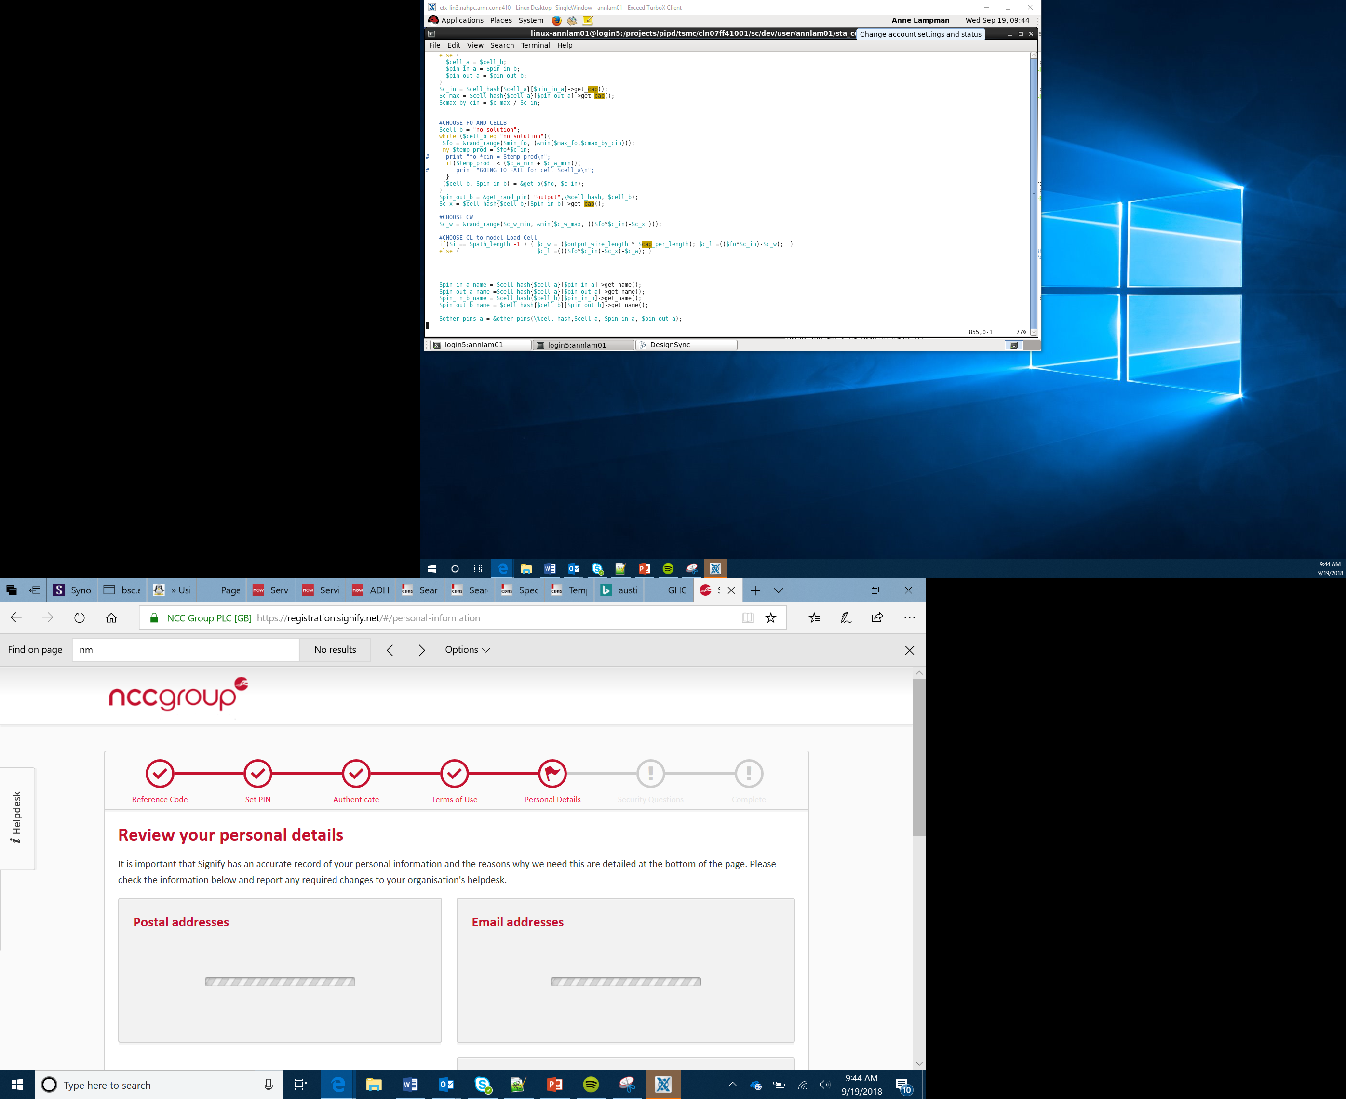

Evaluation
Lesson 34

Slide 2
Objectives
Reflect on the course and projects
Evaluate your learning, progress, designs, communication, teamwork, programming, engineering and creativity
Describe what you would do better next time

Slide 3

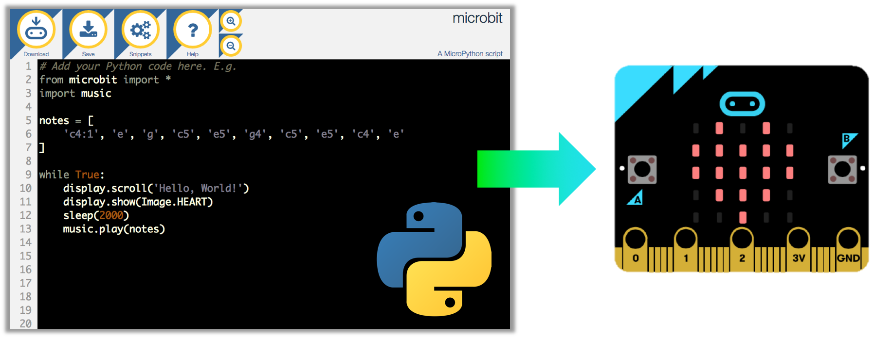
What we have achieved so far

Slide 4
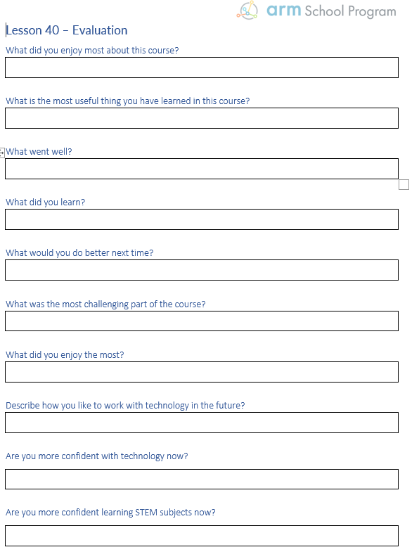
Evaluation task
Use the evaluation worksheet to reflect on this course
Use full sentences
Describe as best you can what went well and what could have been improved
Discuss your answers with your peers

Slide 5

Notes:
Introduce the concept of the global goals

Slide 6
Final task
Choose a global goal
Using everything you have learned so far, start to design a solution to one of the problems
Be creative!

